Slide 1

Why declarative UI frameworks? Thomas Künneth

Slide 2

Many UI frameworks are object oriented
In the code each UI element is represented by a class
During runtime, the UI is represented through an object graph

Slide 3

To change the UI, we modify object properties
Callbacks / listeners handle interactions (behavior)
Get and main references to all required objects (UI elements)
https://unsplash.com/photos/E75ZuAIpCzo

Slide 4

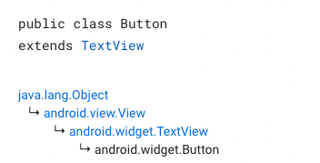
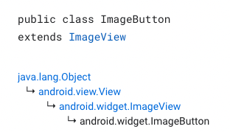
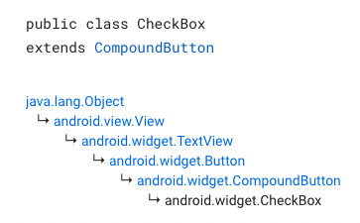
Specialization through inheritance
Override to change behavior
✔️ Awesome for small to modest changes
⚠️ But what if we can‘t extend a class?
Mixing components may not be easy
https://unsplash.com/photos/QgeIMfZJgFs

Slide 5
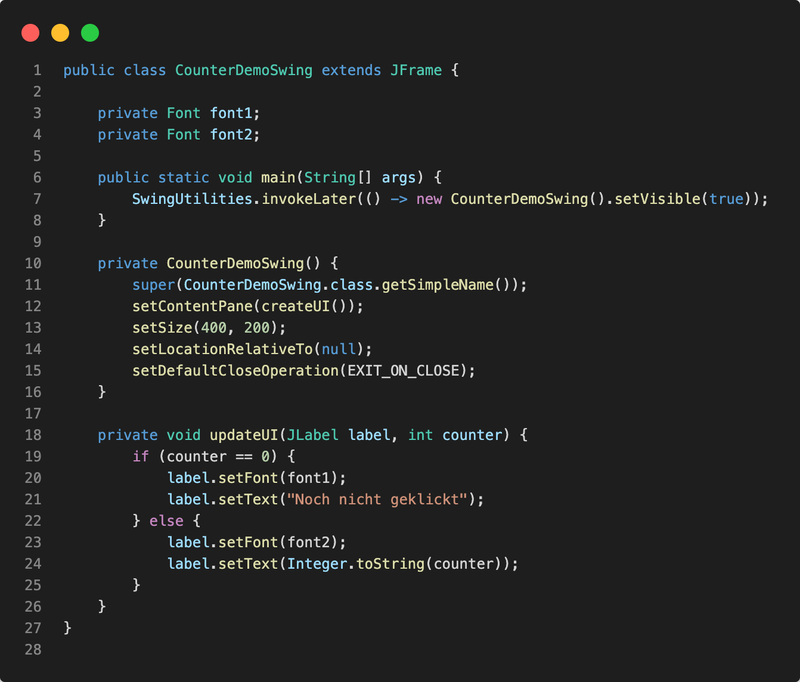
Provide an app frame
Build a component tree
Update UI based on data

Slide 6
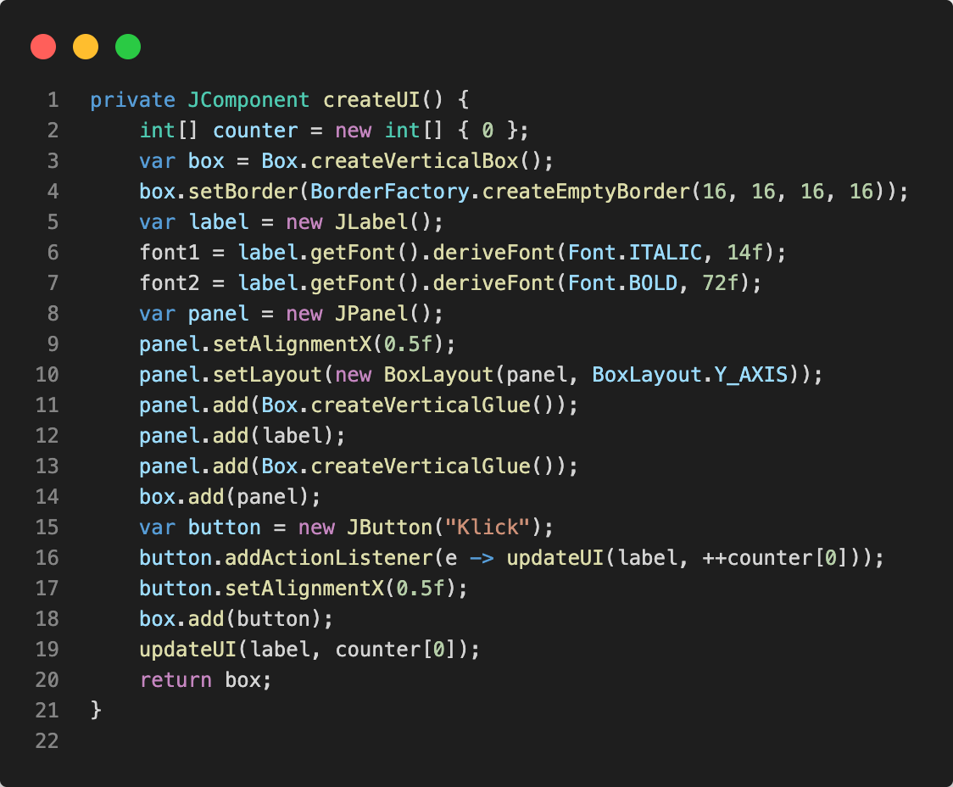
Define state
Create and configure components
Modify state and update UI

Slide 7

Tight coupling between data and logic
Creating the UI bloats the source code
Even for small UIs the code is not too easy to understand

Slide 8
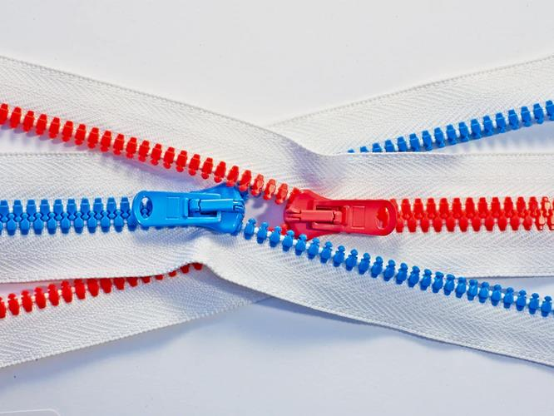
Separation of UI definition and code
Makes the source code lighter
UIs are easier to design, maintain, and share
https://unsplash.com/photos/nVqNmnAWz3A

Slide 9
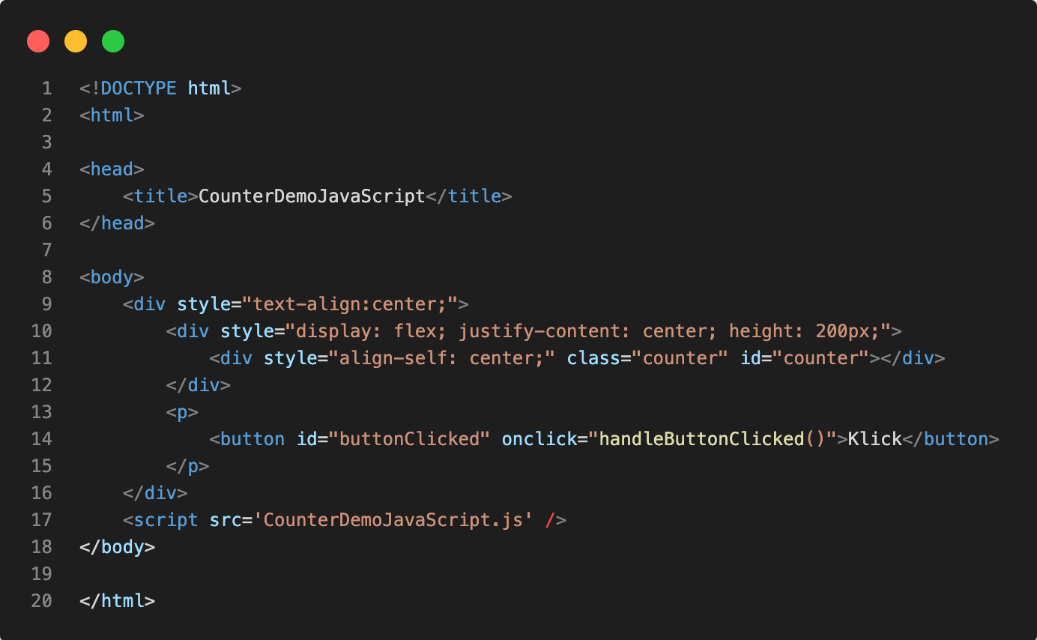
Declare a tree of components
Define parts of visual appearance
Connect UI elements to code

Slide 10
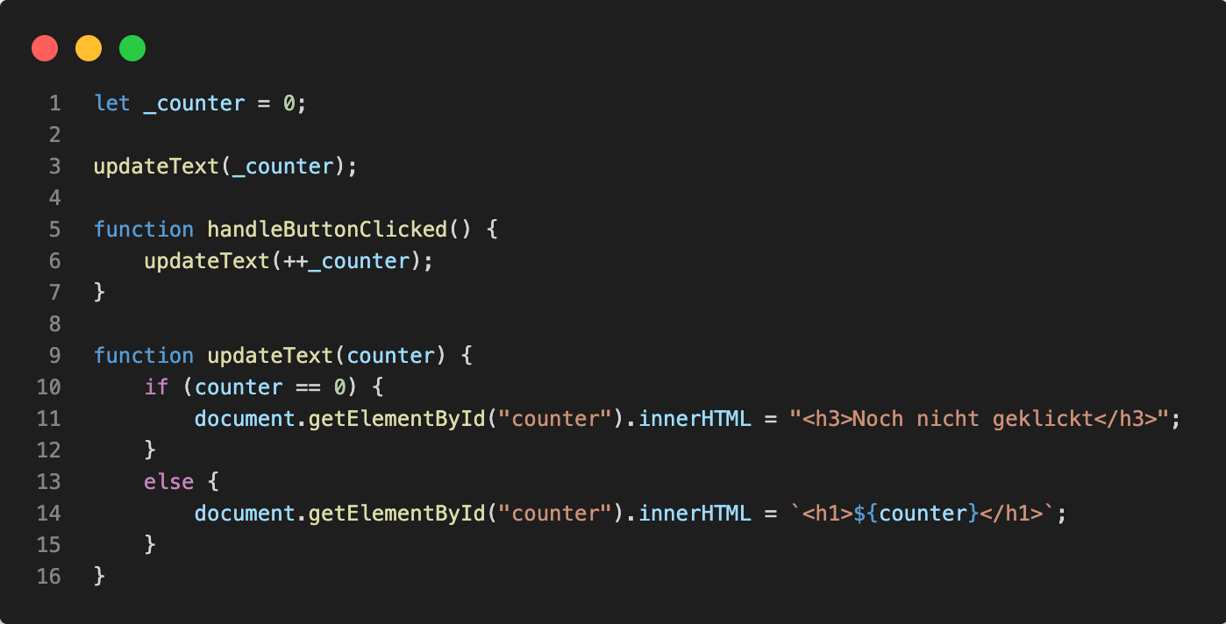
Define state
Modify state
Update UI based on state
Connect code to the UI tree

Slide 11

Looks elegant
Was adopted by many UI frameworks
JavaFX (FXML)
macOS / iOS (Storyboard)
WPF, Xamarin (XAML)
Android (XML)
https://unsplash.com/photos/4hbJ-eymZ1o

Slide 12
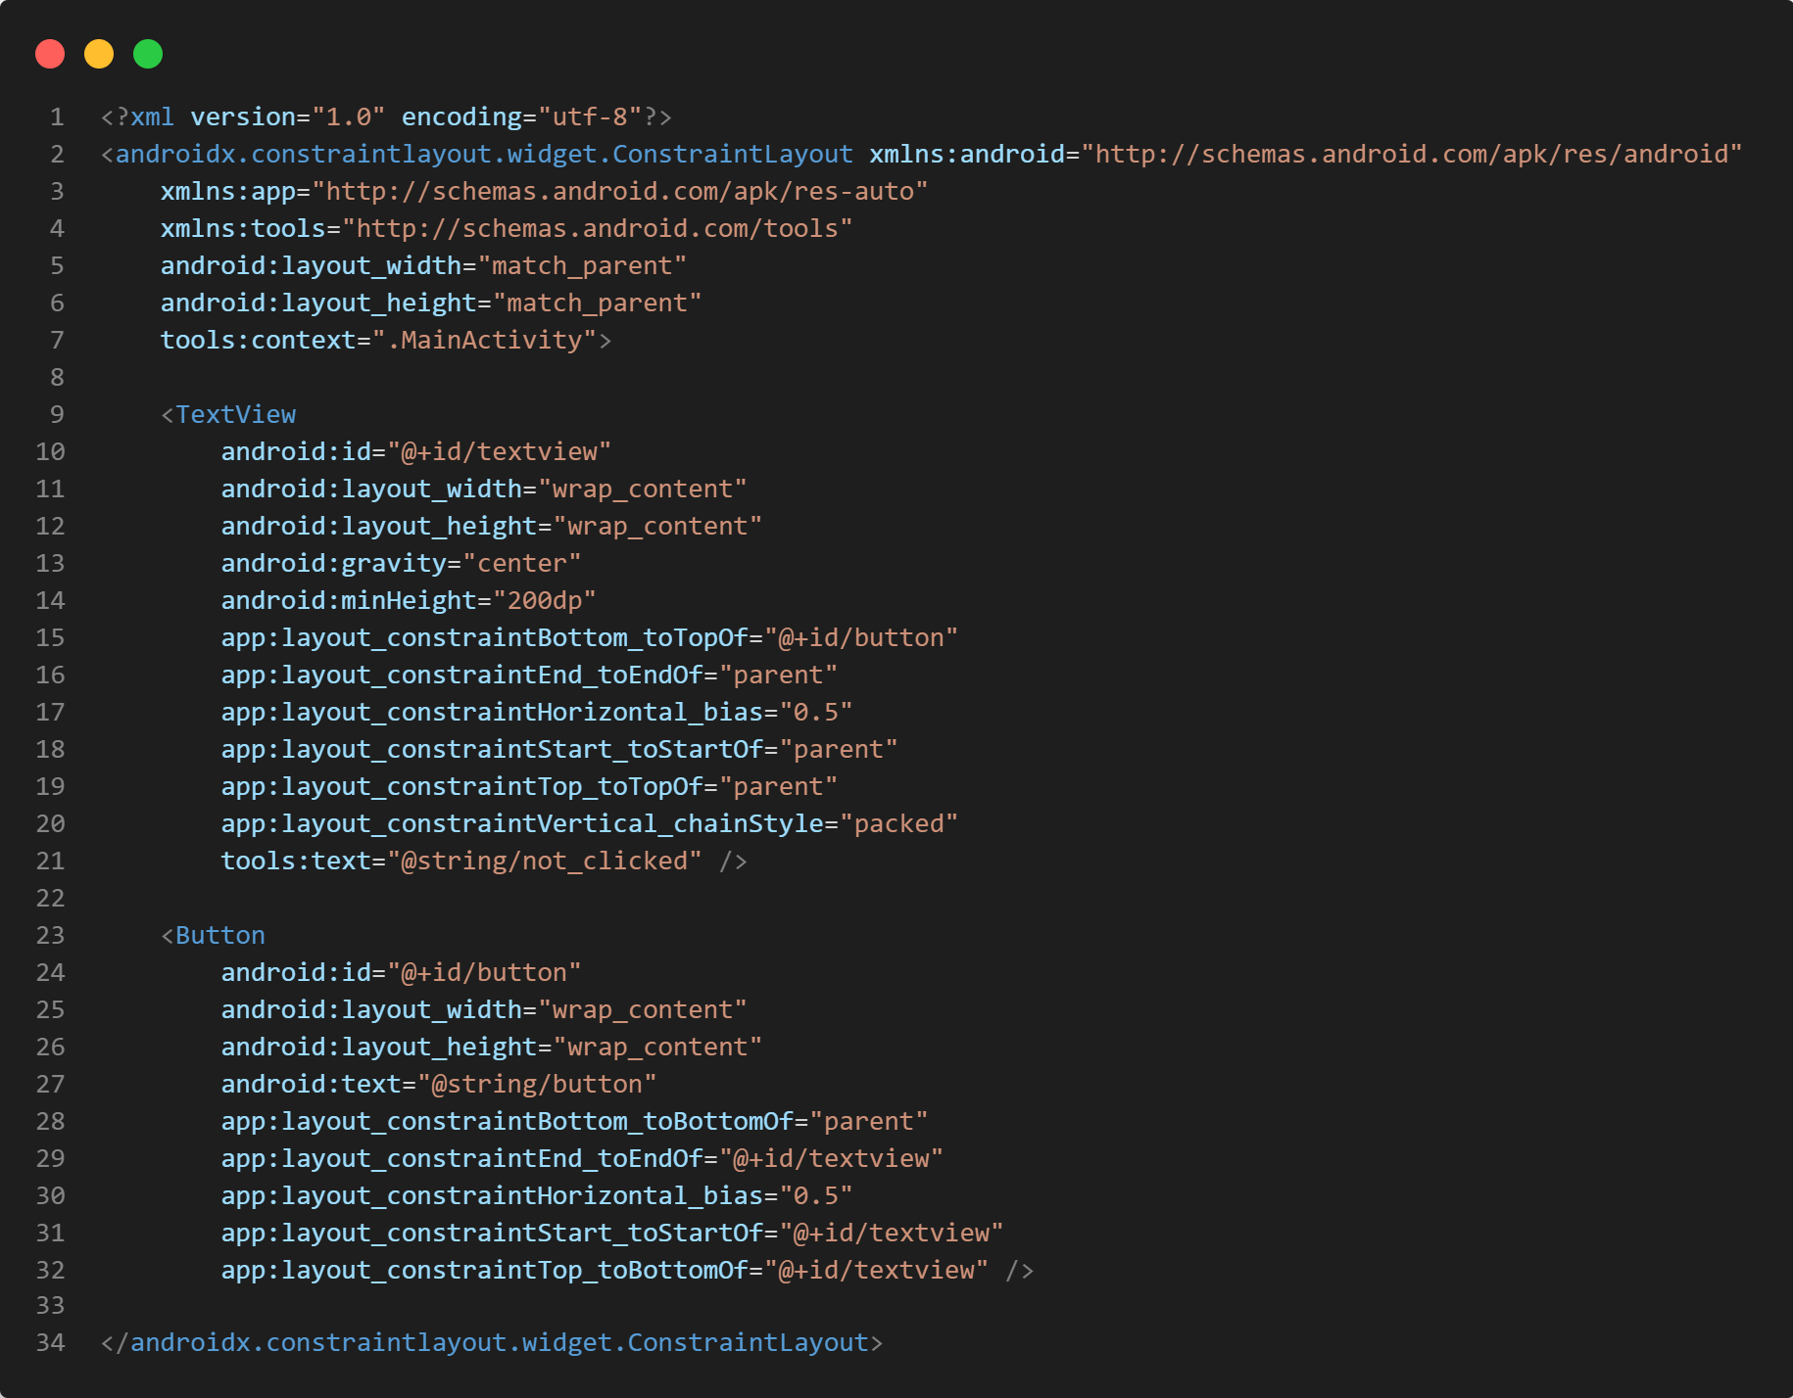
Define a tree of components
Define parts of visual appearance
Connect UI elements to code

Slide 13
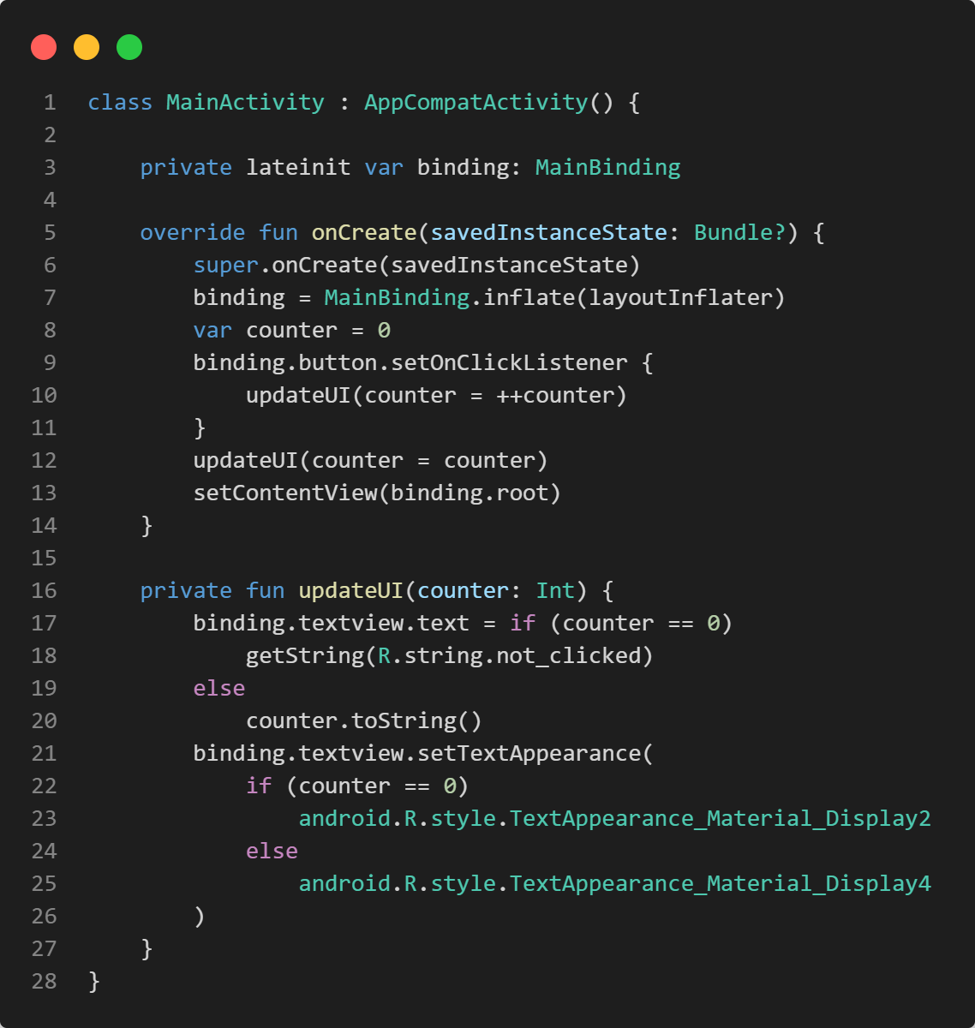
Create an activity
Build a component tree
Update UI based on data

Slide 14

History proved that separating UI definition and behavior did not solve all problems
To truly make code more robust, maintainable, and easy to understand, additional measures were needed
Design patterns: MVP, MVVM, MVC, …

Slide 15

https://unsplash.com/photos/i--IN3cvEjg

Slide 16
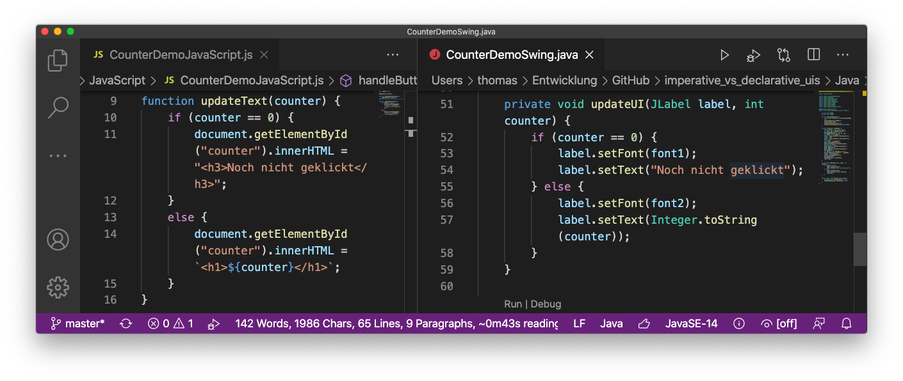
Update UI based on data
Update UI based on data

Slide 17
Changes to the UI are still done through changes to the object graph / data structures
Developer must know who the way from is to will be …
… and implement it
The bigger the change, the more difficult this may be

Slide 18

Changing the UI necessary
when data shown to the user changes
upon navigation
Data and component tree live on their own
Important to keep both in sync
https://unsplash.com/photos/slbOcNlWNHA

Slide 19


manually
with magic
https://unsplash.com/photos/qjX0QBtDXto
https://unsplash.com/photos/AJ_Mou1FUS8

Slide 20


UI frameworks learned to sync app and UI data through a binding mechanism
Read-only components just need one-way bindings
Components with user interaction require two-way binding
Zip code
zip_code

Slide 21

Any change to the UI must be explicitly coded, either by changing component properties, or by modifying the tree itself
https://unsplash.com/photos/KbPVj7knbTU

Slide 22

Works well in small projects, but doesn‘t really scale
https://unsplash.com/photos/KnQ980sdlqU

Slide 23

Declarative UI frameworks
https://unsplash.com/photos/yg8pLPTAY8M

Slide 24

No longer require the developer to know the way from A to B
So, no longer…
How do I change xyz, so that it looks like…?
Which objects do I hide / add / delete, in order to…?
https://unsplash.com/photos/fteR0e2BzKo

Slide 25
Instead:
How should the UI look now?
Which elements are visible?
And what are their features?
How to do that is the job of the framework, not the developer
Pioneer Web: React with Virtual DOM

Slide 26
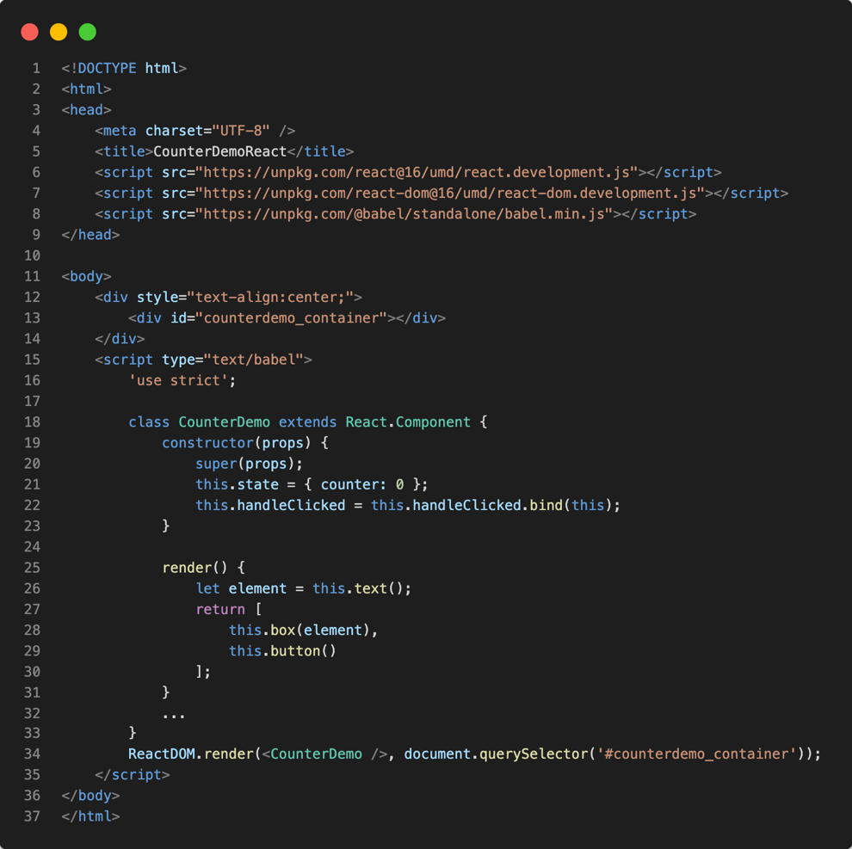
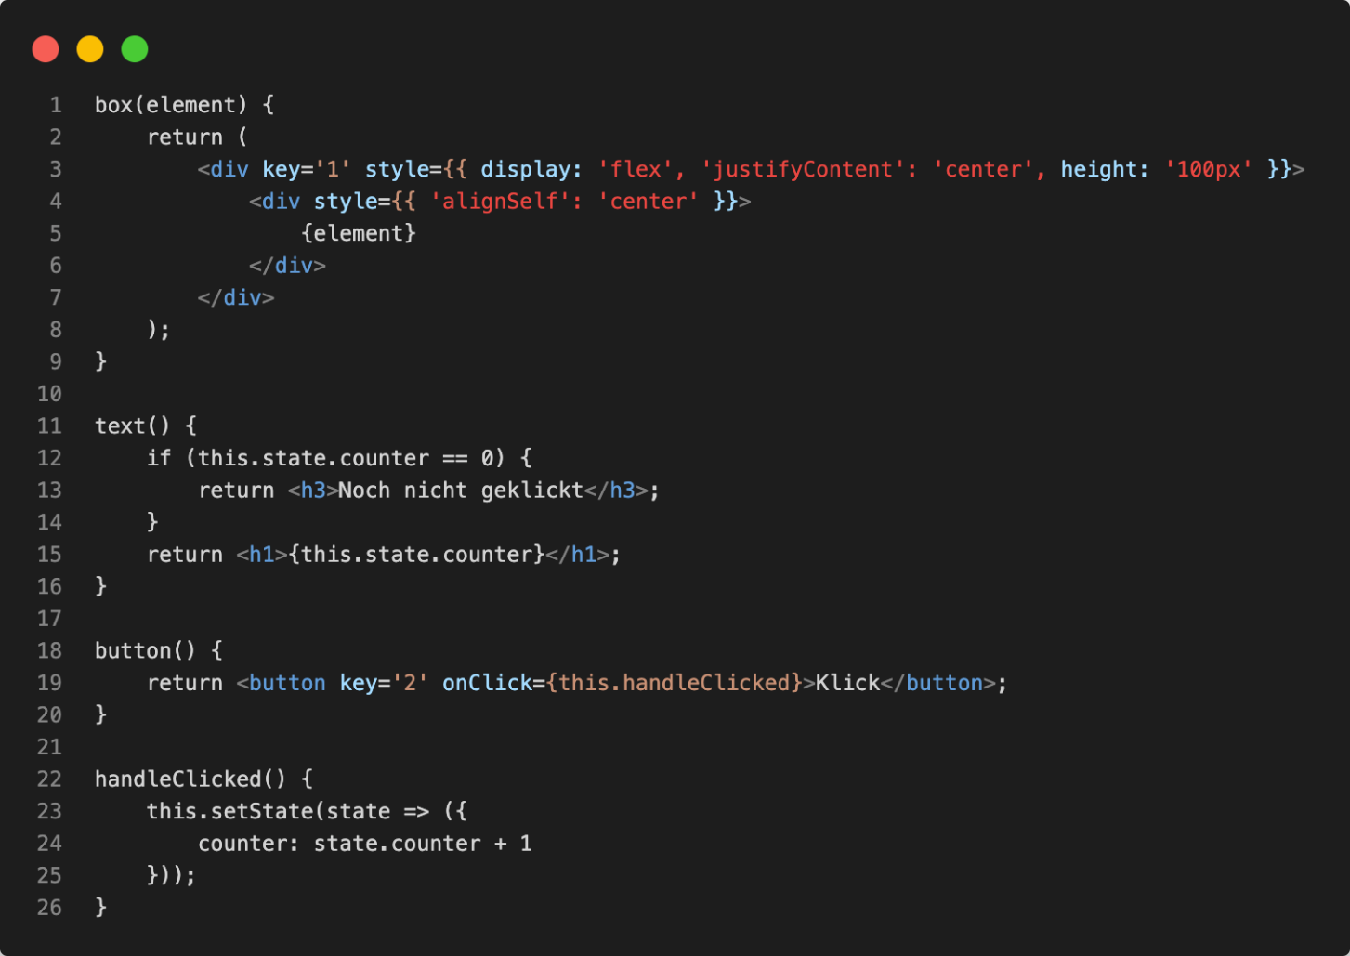
Declaration of the UI is based on state
The component is based on state
State changes are wrapped inside setState()
Tell React to render a component

Slide 27

Flutter (2015)
SwiftUI (2019)
Jetpack Compose (2019)

Slide 28

User interface is declared based on state
No need to modify (transform) the existing component tree
UI updates itself upon state changes

Slide 29

Frameworks maintain internal representation of the user interface
Must make sure that state changes trigger updates
(Should be) irrelevant for the application developer
... it is most of the time ...
https://unsplash.com/photos/wdxb9OOMQOs

Slide 30
Traditional UI frameworks are based on components
A component has a fixed set of properties to configure appearance and behavior
Inheritance is used to modify or expand both
Several parents possible only with multiple inheritance

Slide 31
Declarative UI frameworks may rely on components, too
They may even rely on properties to define appearance and behaviour

Slide 32
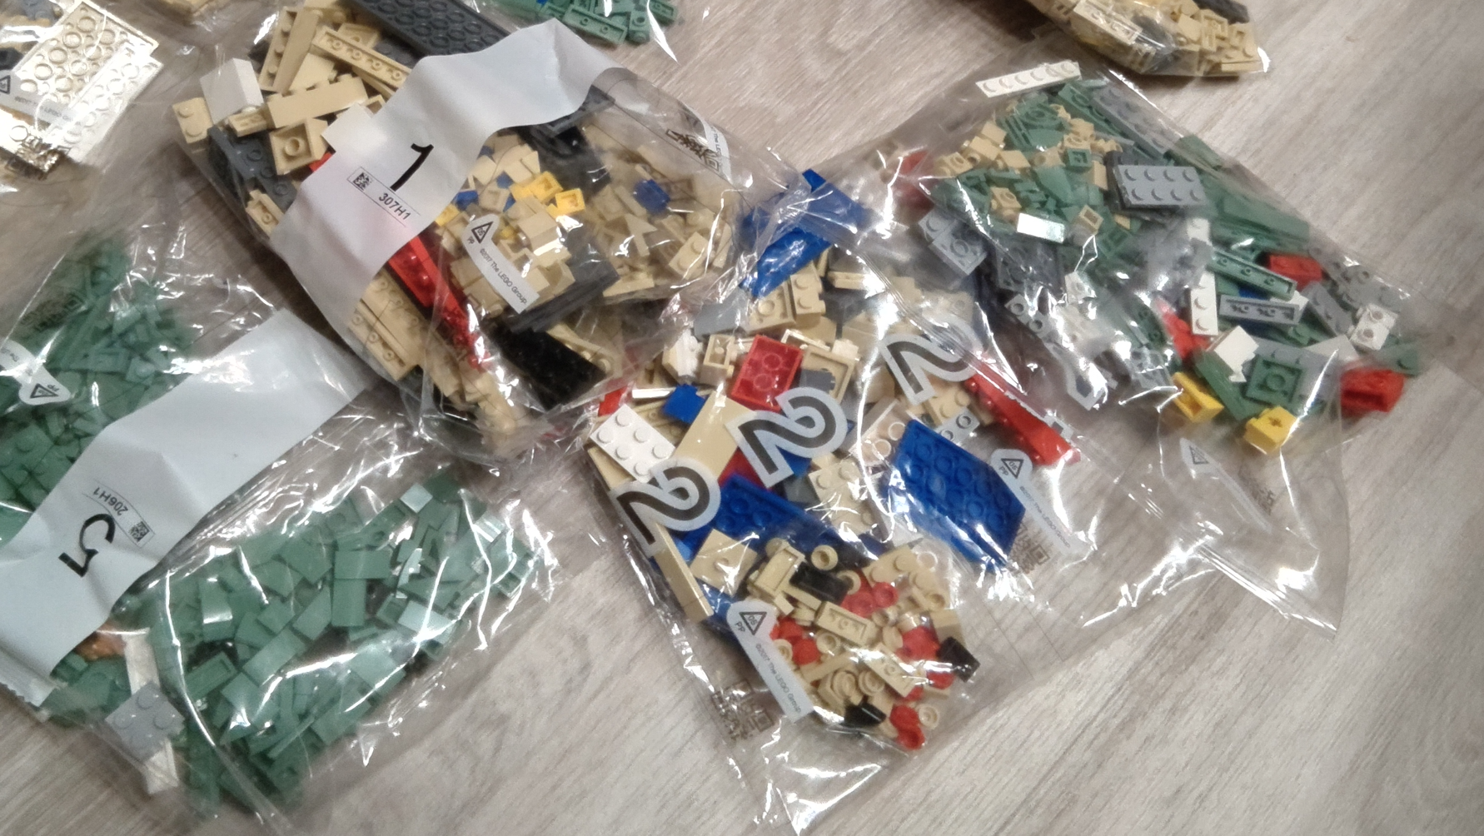
But they favor combining small, reusable building blocks
Composition over inheritance

Slide 33
Fast development cycles
Lean code
Preview in the IDE or „hot reload“
Static code analysis for UI, too
https://unsplash.com/photos/HUJDz6CJEaM

Slide 34
Frameworks still evolve fast
UI implementation is again done by the developer
https://unsplash.com/photos/ij5_qCBpIVY

Slide 35

Paradigm shift
Prevent bugs through avoiding boilerplate code
Once adopted, high productivity
https://unsplash.com/photos/j06gLuKK0GM

Slide 36

Exercise
https://unsplash.com/photos/IZOAOjvwhaM

Slide 37
What are the most striking differences between declarative and imperative UI frameworks?
So, declarative UI frameworks don’t use components?
Can you think of potential pitfalls with the declarative approach?

Slide 38

Further reading
Chapter 2: Understanding the Declarative Paradigm
free PDF

Slide 39

Questions…?
Short break… 😍

